Slide 1
User Interface Basics

Slide 2
Introduction
A graphical user interface (GUI) makes a system user-friendly and easy to use
Creating a GUI requires creativity and knowledge of how GUI components work
The GUI components in Java are very flexible and versatile, you can create a wide assortment of useful user interfaces

Slide 3
Introducing Swing
Swing is the name of Java’s graphics framework
Swing gives a consistent experience across platforms
Swing is virtualized making it more flexible
It has few dependencies on the o/s

Slide 4
WindowBuilder
WindowBuilder is a WYSIWYG, drag-and-drop interface that lets developers create Java GUIs
It generates clean Java code, with the visual design and source always in sync
It allows the flexibility of working in the GUI builder and in the source code – whichever is more efficient

Slide 5
WindowBuilder + eclipse
WindowBuilder is pre-installed in the release of Eclipse IDE for Java Developers
It is not installed in Eclipse IDE for Java EE Developers

Slide 6
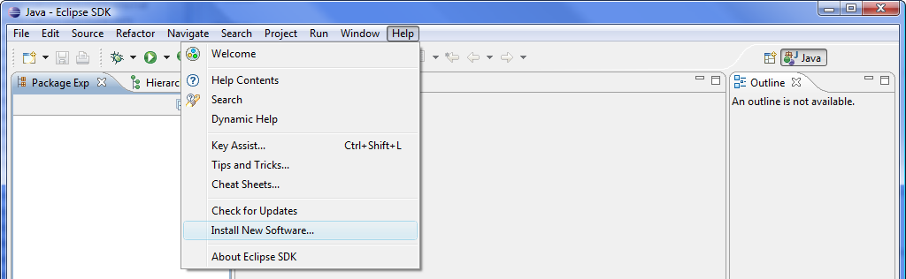
Installing WindowBuilder
If it isn’t installed…
Select "Help > Install New Software..." in the main menu to open the "Install" dialog

Slide 7
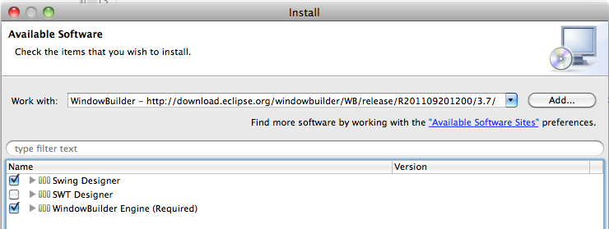
Installing WindowBuilder
Go to http://eclipse.org/windowbuilder/download.php, copy the appropriate URL into the "Work with" field of the "Install" dialog
Click “Add…
Use the Name “WindowBuilder”
Select “Swing Designer” & “WindowBuiler Engine”
Then “Next >” “Next >” “Accept” “Finish”
Restart eclipse when prompted

Slide 8
Create a Starter Java Project
New > Java Project
SwingDemo
Finish
Create a SwingDemo class with a main method in an appropriate package (ex. a00123456.swingdemo)
Create a ui sub-package to hold the ui components

Slide 9
Creating a Frame
A frame is a "top-level" window
The JFrame extends java.awt.Frame and is one of the few Swing components that is not painted on a canvas as it uses the decorations are drawn by the underlying windowing system

Slide 10
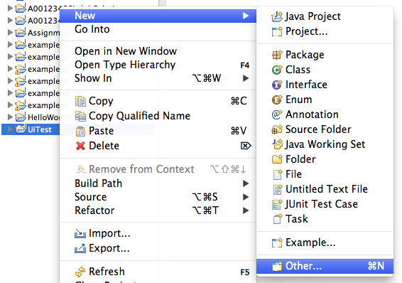
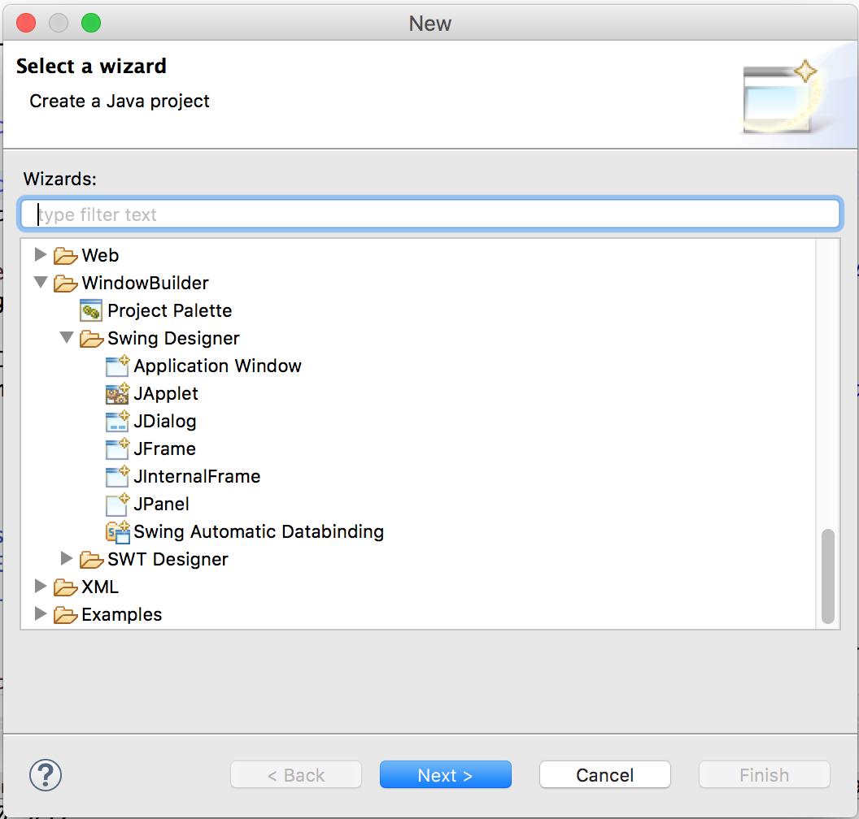
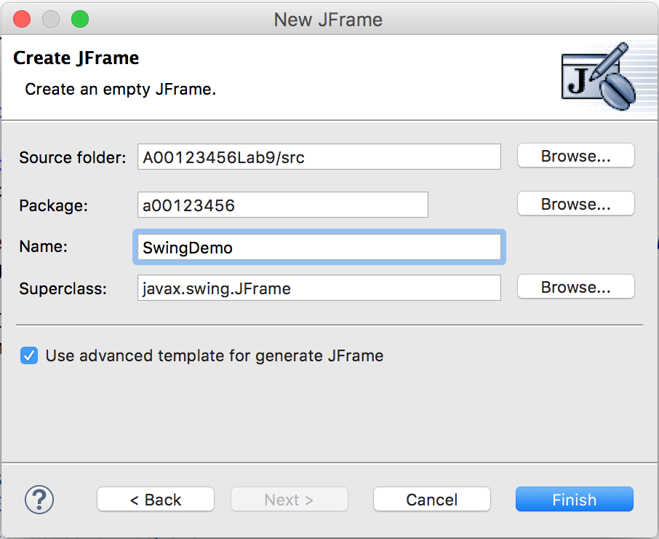
Add a JFrame to the Project

Slide 11
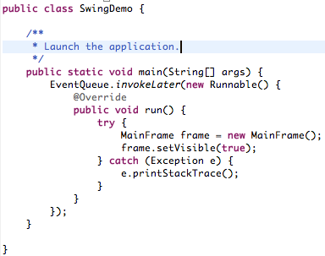
Refactor the code
Move the main method to the SwingDemo class
Run it!

Slide 12
Exploring MainFrame
Swing classes are in the javax.swing package
EventQueue.invokeLater …
If frame.setVisible(true) isn’t called, the frame will not be displayed
After creating the Frame, the main thread exits, but the program doesn’t shut down
The event dispatch thread keeps the program running
setDefaultCloseOperation(JFrame.EXIT_ON_CLOSE) allows the frame to be closed by the user

Slide 13
Frame Methods
setLocation and setBounds set the position of the frame
setIconImage sets the icon in the title bar
setTitle changes the text in the title bar
setResizable allows, or not, the user to resize the frame

Slide 14

Look & Feel
Swing provides a feature to modify the overall ‘look and feel’ of an application
Typically the ‘native’ L&F is used, but if a consistent experience is desired across operating systems then a specific L&F can be used
For this course, we’ll use the Nimbus L&F

Slide 15
Setting the Nimbus L&F
Add the following code to the event-dispatching thread before creating the frame
import javax.swing.UIManager;
import javax.swing.UIManager.LookAndFeelInfo;
…
try {
for (LookAndFeelInfo info:UIManager.getInstalledLookAndFeels()) {
if ("Nimbus".equals(info.getName())) {
UIManager.setLookAndFeel(info.getClassName());
break;
}
}
} catch (Exception e) {
// If Nimbus is not available, use the default.
}

Slide 16

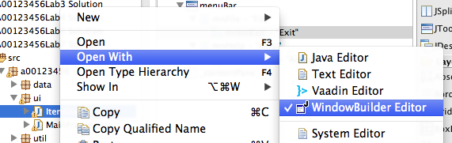
Opening existing ui classes
If for some reason the design tab doesn’t appear…

Slide 17
Layout Managers
Layout managers are not GUI components
helpers to GUI components
lay out placing and sizing of components
you can put a new layout manager in each container
each container has its own layout manager
FlowLayout, GridLayout, BorderLayout, CardLayout, BoxLayout, GridBagLayout, SpringLayout, …

Slide 18
Layout Managers
Layout manager:
works with containers
most change the size of components to fit relative rules of their layout
relative positioning NOT absolute (i.e. pixel by pixel)
components always have a default layout
Why shouldn't I use absolute positioning?
Internationalization, flexibility
Setting the layout:
setLayout(new MiGLayout));

Slide 19
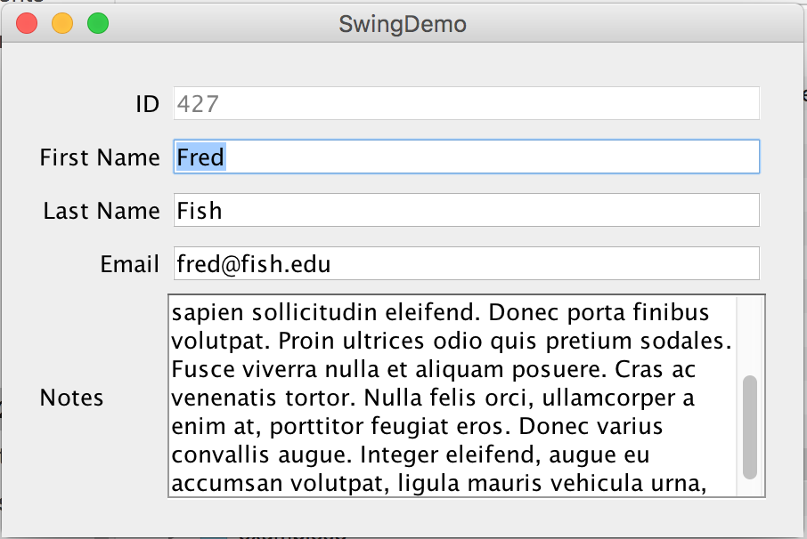
Goal
We’ll build this…

Slide 20
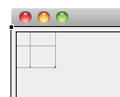
MigLayout
Set the layout for the JFrame to MiGLayout
Design
MigLayout (under ‘Layouts’)
Click on the ‘contentPane’ in the frame

Slide 21
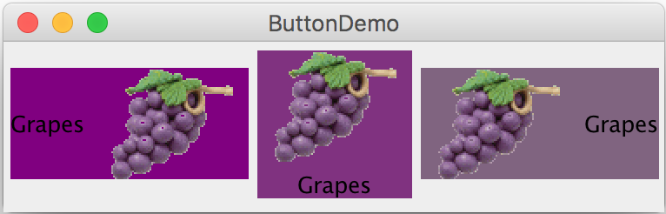
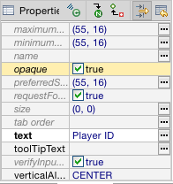
JLabel
A label is a display area for brief text, an image, or both

Slide 22
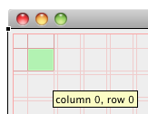

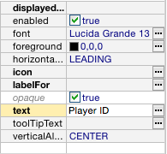
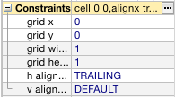
JLabel
JLabel (under ‘Components’)
Click the desired cell location (ex. 0,0)
enter the text

Slide 23
JTextField
A text field is an input area where the user can type in characters
Text fields are useful in that they enable the user to enter in variable data (such as a name or a description)

Slide 24
JTextField
Click JTextField (under ‘Components’)
Click the desired cell location (ex. 1,0)
Give your component a decent name

Slide 25
JTextArea
If you want to let the user enter multiple lines of text, you cannot use text fields unless you create several of them
The solution is to use JTextArea, which enables the user to enter multiple lines of text
Note the use of JScrollPane in the example

Slide 26

JTextArea
Add a ‘Description’ label then…
Select JTextArea (under ‘Components’)
Click the desired cell location (ex. 1,1)
give your component a decent name
ex. descriptionField
Test your app…

Slide 27
Adding Scrolling Support
By default, the JTextArea doesn’t support scrolling, so you’ll need to add this capability
The easiest way to do this is to edit the code
Select the ‘Source’ tab
Modify the source code
contentPane.add(new JScrollPane(descriptionField), "cell 1 1, grow");

Slide 28
The Color Class
You can set colors for GUI components by using the java.awt.Color class. Colors are made of red, green, and blue components, each of which is represented by a byte value that describes its intensity, ranging from 0 (darkest shade) to 255 (lightest shade). This is known as the RGB model.
Color c = new Color(r, g, b);
r, g, and b specify a color by its red, green, and blue components.
Example:
Color c = new Color(228, 100, 255);

Slide 29
Standard Colors
Thirteen standard colors, BLACK, BLUE, CYAN, DARK_GRAY, GRAY, GREEN, LIGHT_GRAY, MAGENTA, ORANGE, PINK, RED, WHITE, and YELLOW are defined as constants in java.awt.Color
Java gives you predefined names for more colors in the SystemColor class
For example SystemColor.window

Slide 30
Setting Colors
You can use the following methods to set the component’s background and foreground colors:
setBackground(Color color)
setForeground(Color color) i.e. the text color
Example:
myComponent.setBackground(Color.YELLOW);
myComponent.setForeground(Color.RED);

Slide 31
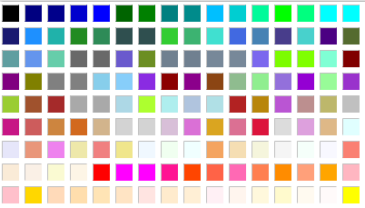
Color
Select the ‘Product Number’ label
Select ‘…’ on the ‘foreground’ line in the properties tab
Pick a colour

Slide 32
The Font Class
Font myFont = new Font(name, style, size);
Example:
Font myFont = new Font("SansSerif ", Font.BOLD, 16);
Font myFont = new Font("Serif", Font.BOLD+Font.ITALIC, 12);
Point Size
measured in 1/72 inch
Font Names
Standard font names that are supported in all platforms are: SansSerif, Serif, Monospaced, Dialog, or DialogInput.
Font Style
Font.PLAIN (0), Font.BOLD (1), Font.ITALIC (2), and Font.BOLD +
Font.ITALIC (3)
The JDK always includes three font families:
Lucida Sans, Lucida Bright, and Lucida Sans Typewriter

Slide 33
Fonts
Select the ‘Description’ label
Select ‘…’ on the ‘font’ line in the properties tab
Then select an appropriate font
Note: a good user interface will limit the use of different fonts
WB

